Slide 1


Storytelling and Multivariate displays
Sheetal Pereira
Assistant Professor
Department of Computer Engineering
K. J. Somaiya College of Engineering
Somaiya Vidyavihar University
Notes:
https://paldhous.github.io/ucb/2016/dataviz/week2.html

Slide 2
THE SCIENCE OF STORYTELLING
Media and journalists are the ones putting emphasis on data storytelling.
we’ve seen the power of storytelling used to color in
conversations on just about every type of data imaginable—from challenging astronomical principles, to visualizing the tenure pipeline to quantifying the fairytale of Little Red Riding Hood.
In every organization and every industry, data stories are becoming the next script for how we share information.
For as diverse as data stories can be, they all have one thing in common: They give us something to connect to in a very literal sense.

Slide 3
THE SCIENCE OF STORYTELLING
The Brain on Stories:
The cognitive effects of storytelling embedded within our neurology.
When we are presented with data, only two parts of our brain respond. These are Wernicke’s area—responsible for language comprehension—and Broca’s area—responsible, again, for language processing.

Slide 4
THE SCIENCE OF STORYTELLING
The Brain on Stories:
For the very powerful human brain, data is easy. The brain’s response to these stimuli is a relatively simple input-and respond transaction that requires the utilization of these two basic areas.
Because we’re focused only on seeing and responding to information (agree/disagree), there’s no great
need to overexert our neuro-horsepower.

Slide 5
THE SCIENCE OF STORYTELLING
The Brain on Stories:
For the very powerful human brain, data is easy. The brain’s response to these stimuli is a relatively simple input-and respond transaction that requires the utilization of these two basic areas.
Because we’re focused only on seeing and responding to information (agree/disagree), there’s no great
need to overexert our neuro-horsepower.
stories require a substantial cognitive boost. E.g. pasta for dinner.

Slide 6
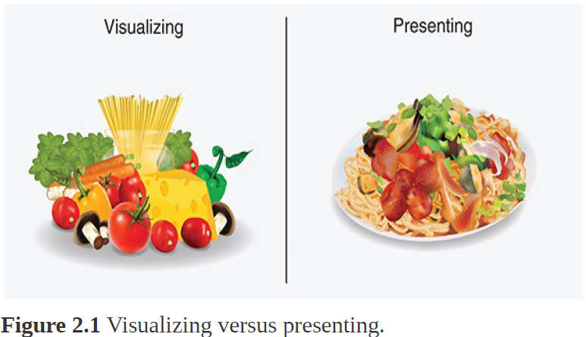
THE SCIENCE OF STORYTELLING
The Brain on Stories:
This is the difference between visualizing data, and presenting a story: rather than itemizing a list of ingredients (data points)
we are presenting a full, sensory-engaging dining experience (see Figure 2.1).

Slide 7
THE SCIENCE OF STORYTELLING
The Brain on Stories:
You can think of this storytelling experience in a more
traditional way, too, by considering the difference in reading a novel and watching a film.
When reading, you are tasked with using your imagination—you’re reading the raw data of words and building the story in your own mind.
Conversely, when watching a film, your imagination is off the hook. Images of characters and settings, costumes, spoken dialogue, music, and so on are displayed for you on the screen. When you watch a live presentation, like a play or a 4D movie, you also get a few extra pieces of sensory information, like the smell of a smoke machine or carefully chosen scents to accompany the story pumping through the air.

Slide 8
THE SCIENCE OF STORYTELLING
The Brain on Stories:
These extra storytelling details have a profound effect on the brain (see Figure 2.2).
Beyond the two areas of the brain that activate when presented with data, when presented with a story, five additional areas respond.
These are
The visual cortex (colors and shapes)
The olfactory cortex (scents)
The auditory cortex (sounds)
The motor cortex (movement)
The sensory cortex/cerebellum (language comprehension)

Slide 9
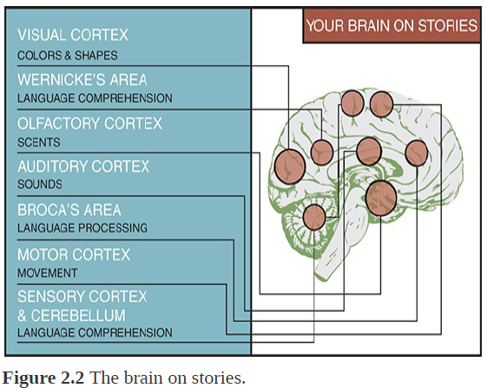
THE SCIENCE OF STORYTELLING
The Brain on Stories:

Slide 10
THE SCIENCE OF STORYTELLING
The Human on Stories:
Storytelling has been an integral part of human expression and culture throughout time.
All human cultures tell stories, and most people derive a great deal of pleasure from them—even if they are untrue.
Beyond entertainment, stories teach us important lessons; we learn from them.
In many cases they are how we transmit information—whether through metaphoric tales, instructions, or legends.

Slide 11
THE SCIENCE OF STORYTELLING
The Human on Stories:
Stories also have the ability to transport us; we
give the author license to stretch the truth—although, in data storytelling, this license extends only as far as it can before the data loses its elasticity and begins to break down.
Data stories, above all, must be true. They are works of narration, but of the non-fiction variety.
Two primary possible contenders for why we tell stories: the need to survive (fitness) and the need to know (closure).

Slide 12
THE SCIENCE OF STORYTELLING
The Human on Stories:
Fitness:
As much as we might try to argue it, human beings did not
evolve to find truth. We evolved to defend positions and
obtain resources—oftentimes regardless of the cost—to
survive.
These concepts are at the heart of Darwinian theory of natural selection: survival of the fittest as the mechanism,
and our ability to overcome (or, biologically, to reproduce),fitness.

Slide 13
THE SCIENCE OF STORYTELLING
The Human on Stories:
Fitness:
Human biology aside to survive in competitive and often unstable environments—whether wilderness or business—one
thing we’ve always had to do is understand other people.
one of our most expensive cognitive tasks where we exert
an impressive amount of energy is in trying to figure out other
people: predict what they’re going to do, understand
motivations, assess relationships, and so forth.
Beyond people, we are also driven to understand how things work. If we know how they work, we can conquer, fix, or control.
All of these lead to winning, which equates to survival and continuation.

Slide 14
THE SCIENCE OF STORYTELLING
The Human on Stories:
Fitness:
Human biology aside to survive in competitive and often unstable environments—whether wilderness or business—one
thing we’ve always had to do is understand other people.
One of our most expensive cognitive tasks where we exert an impressive amount of energy is in trying to figure out other people: predict what they’re going to do, understand motivations, assess relationships, and so forth.
Beyond people, we are also driven to understand how things work.
If we know how they work, we can conquer, fix, or control.
All of these lead to winning, which equates to survival and continuation.
Stories act as guides to give us the information and confidence we need to harness this knowledge. They increase our fitness.

Slide 15
THE SCIENCE OF STORYTELLING
The Human on Stories:
Closure:
Aside from being bent on survival, humans also tend to require closure.
The Zeigarnik effect speaks to our human need for endings. No matter the story’s goal—to focus, align, teach, or inspire—we build narratives to foster imagination, excitement, even speculation.
Successful narratives are those that are able to grab the audience’s attention, work through a message, and then resolve our anxiety with a satisfactory ending. Thus, stories are therapeutic—they give us closure.

Slide 16
THE POWER OF STORIES
Data stories are powerful, and that they are powerful because of their ability to communicate information, generate understanding and knowledge, and stick in our brains.
However, as information assets, visual data stories have a few other noteworthy qualities.
The traditional charts and graphs we’ve always used to represent data are still helpful because they help us to better visually organize and understand information. They’ve just become a little static.

Slide 17
THE POWER OF STORIES
With today’s technology, fueled by today’s innovation, we’ve moved beyond the mentality of gathering, analyzing, and reporting data to collecting, exploring, and sharing information rather than simply rendering data visually we are focused on using these mechanisms to engage, communicate, inspire, and make data memorable.
No longer resigned to the tasks of beautifying reports or dashboards, data visualizations are lifting out of paper, coming out of the screen, and moving into our hearts, minds, and emotions.
The ability to stir emotion is the secret ingredient of visual data storytelling, and what sets it apart from the aforementioned static visual data renderings.

Slide 18
THE POWER OF STORIES
Emotional appeal isn’t enough to complete a meaningful visual data story.
Like any good tale, a data story requires an anchor, or a goal—be it a reveal, a call to action, or an underlying message—to pass to its audience. This idea isn’t unique to data storytelling by any means, but a construct applied to all varieties of stories.
When a story imprints on our memory, it requires emotion plus a willingness to act on that emotion.

Slide 19
THE POWER OF STORIES
Lets look for the following key takeaways:
Sometimes the only way to see the story in data is
visually.
A good story should meet its goals—and it should be
actionable.
A story should change, challenge, or confirm the way you think.
Storytelling evolves—don’t be afraid to try something
new.

Slide 20
THE POWER OF STORIES
The Classic Visualization Example:
One of the core tenants of a visual data story is that it uses different forms of data visualization—charts, graphs, infographics, and so on—to bring data to life.
One of the most archetypal examples of the power of data visualization to help people see and understand data in ways they never would by looking at rows and columns of raw black and white data comes from Anscombe’s Quartet (see Figure 2.3).

Slide 21
THE POWER OF STORIES
The Classic Visualization Example:
Constructed in 1973 by statistician Francis Anscombe, these four datasets appear identical when compared by their summary statistics.
If you review the table, you will notice that each dataset has the same mean of both X and Y, the same standard deviation, the same correlation, and the same linear regression equation.

Slide 22
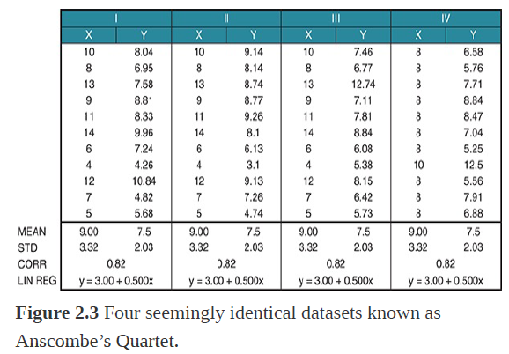
THE POWER OF STORIES
The Classic Visualization Example:

Slide 23
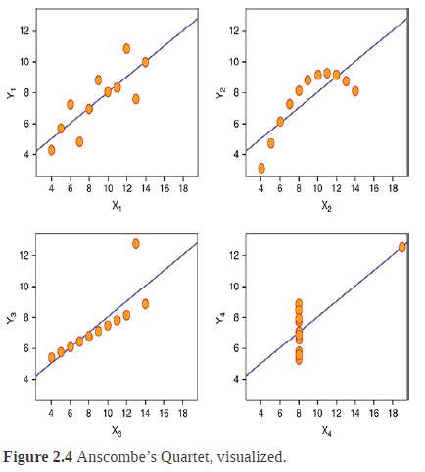
THE POWER OF STORIES
The Classic Visualization Example:

Slide 24
THE POWER OF STORIES
The Classic Visualization Example:
Even though the individual variables are different, if the statistical outputs are the same, we would expect these, when graphed, to look the same.
The “story” for each of these datasets is different.
When graphed (see Figure 2.4), we can see beyond the limitations of basic statistical properties for describing data, and can tell a bigger picture of the datasets and the relationships therein.

Slide 25
THE POWER OF STORIES
Using small personal data for big stories
A good story should meet its goals-and it should be actionable.

Slide 26
THE POWER OF STORIES
The Two-or-Four season debate
A story should change , challenge or confirm the way you think.

Slide 27
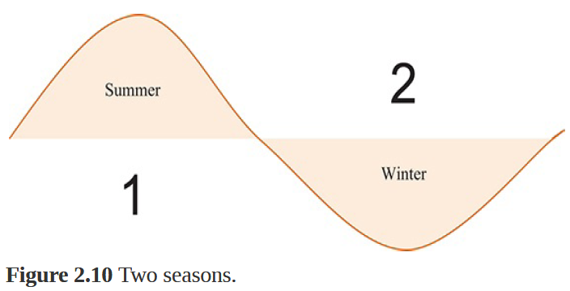
THE POWER OF STORIES
The Two-or-Four season debate
A story should change , challenge or confirm the way you think.

Slide 28
THE POWER OF STORIES
Napoleon’s March:

Slide 29
Context in Action
Without context data is “meaningless, irrelevant, and even dangerous”.
Without context we can’t answer any of the pivotal journalistic questions—who , what, where, when, why, and how—that provide pertinent details to help us get to the bottom of any big question.

Slide 30
Context in Action
Harry Potter: Hero or Menace?
The Harry Potter series has been distributed in more than 200 territories, translated into 68 languages, and has sold more than 400 million copies worldwide.

Slide 31
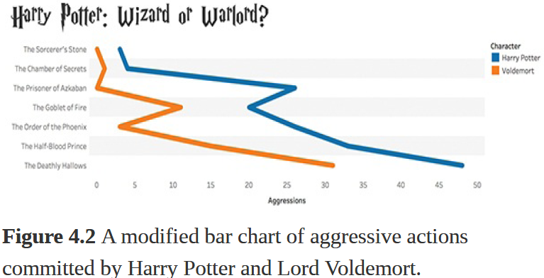
Context in Action
Harry Potter: Hero or Menace?

Slide 32
Context in Action
Ensuring Relevant Context:
To make sure we’re including context in a meaningful way, we need to revisit our initial assumptions of how we approached visualizing two key variables: the two characters and their aggressive acts.
Out of Context: How many times Harry and Voldemort acted aggressively.
In Context: How often Harry and Voldemort acted aggressively when mentioned.
Putting the data back into a relevant context, when we visualize again we see something very different (see Figure 4.3).

Slide 33
Context in Action
Ensuring Relevant Context:

Slide 34
Context in Action
Ensuring Relevant Context:
With more context added into the narrative, we see
Voldemort’s true colors emerge.
While Harry rarely acts aggressively when mentioned, Voldemort usually acts aggressively when his name is spoken.
This completely changes the story takeaway that we presented before.

Slide 35
EXPLORATORY VERSUS EXPLANATORY ANALYSIS
Before moving on to looking at storytelling techniques and story structures, we need to draw a distinction between exploratory and explanatory analysis, and how these contribute to storytelling.

Slide 36
EXPLORATORY VERSUS EXPLANATORY ANALYSIS
Before moving on to looking at storytelling techniques and story structures, we need to draw a distinction between exploratory and explanatory analysis, and how these contribute to storytelling.
Exploration fuels discovery. It’s the process we take to explore data and uncover its story.

Slide 37
EXPLORATORY VERSUS EXPLANATORY ANALYSIS
Example is an image of Indiana Jones to illustrate the concept of exploratory analysis because, like Dr. Jones, this is where we go looking for a discovery to share and hope to find something.
We take time to search, digging in and out of data
iteratively and with curiosity as we work to build a story, or perhaps many stories, or perhaps even none at all.
Exploration is a process of “look and see,” and we must explore before we can explain.

Slide 38
EXPLORATORY VERSUS EXPLANATORY ANALYSIS
Our job as analysts is to explore. Our job as data storytellers is to explain.
Exploratory analysis might yield important story points, but they are not part of the storytelling process.
As storytellers, we are focused on explanatory analysis and communicating our discoveries in the form of a story.

Slide 39
EXPLORATORY VERSUS EXPLANATORY ANALYSIS
The distinction between explanatory and exploratory analysis has an important impact on context, particularly in how we present our results.
In addition to telling a story, data storytellers must also act as their own editors.
This requires trimming unnecessary content away so that the core of the data story remains unencumbered
and intact.

Slide 40
Structuring Stories
Like traditional stories, data stories have shape—and not just bars and bubbles—or “structure.”
Story structure plays an important role in developing a story’s context, and can be broken down into two parts:
Part One: Story Plot
Part Two: Story Genre

Slide 41
Structuring Stories
1.Story Plot:
The events of a story (or the main part of a story) are its plot (this is also called its storyline).
These events generally relate to each other in a pattern or a sequence, and the storyteller (or author) is responsible for arranging these actions in a meaningful way to shape the story.

Slide 42
Structuring Stories
1.Story Plot:

Slide 43
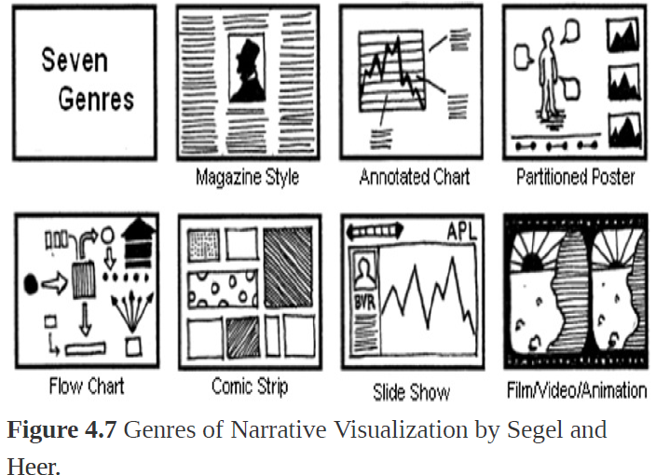
Structuring Stories
1.Story Plot:
For the purposes of data storytelling, there are eight basic “plots” to help shape your visual data story (see Figure 4.7).

Slide 44
Structuring Stories
1.Story Plot:
Change over time—See a visual history as told through a simple metric or trend
Drill down—Start big, and get more and more granular to find meaning
Zoom out—Reverse the particular, from the individual to a larger group
Contrast—The “this” or “that”

Slide 45
Structuring Stories
1.Story Plot:
Spread—Help people see the light and the dark, or reach of data (disbursement)
Intersections—Things that cross over, or progress (“less than” to “more than”)
Factors—Things that work together to build up to a
higher-level effect
Outliers—Powerful way to show something outside the realm of normal

Slide 46
Structuring Stories
2. Story Genre:
The other half of story structure is its genre. Like the diversity in plot, there is more than one genre to choose from.
In fact, there are seven genres of narrative visualization.
Developed by Segel and Heer, they vary primarily in the number of frames and the ordering of visual elements and include the magazine style, the annotated chart, the partitioned poster, the flow chart, the comic strip, the slide short, and finally, the conglomerate film/video/animation (see Figure 4.7).

Slide 47
Structuring Stories
2. Story Genre:

Slide 48
Structuring Stories
2. Story Genre:
Data stories are most effective when they have constrained interaction at various checkpoints and allow the user to explore and engage with the story without veering too far away from the intended narrative.
Stories unfold, and each visualization should highlight one story point at a time (whether within the same visualizations or within multiple) as storytellers layer points to build a complete data narrative.

Slide 49
AUDIENCE ANALYSIS FOR STORYTELLING
A successful data storyteller has to be a master of their craft, able to meld the worlds of data visualization and storytelling together into a cohesive whole.
However, the story is only half of the equation.
A story is a piece of communication, and like every communication, stories are part of a two-way dialogue between the sender (you) and the receiver (your
audience).

Slide 50
AUDIENCE ANALYSIS FOR STORYTELLING
If the story gets interrupted or otherwise lost in translation, you’ve lost the ability to communicate and will likely fail.
Therefore, storytellers need to be clear on exactly who is on the receiving end of their story, and have confidence that they have the information they need to build the right story for their audience.
A good storyteller knows that the trick isn’t asking the right questions, but in asking many.

Slide 51
AUDIENCE ANALYSIS FOR STORYTELLING
It’s iterative, and a process of compromise between what you want to say and what the audience needs to hear.
Ultimately you need to be able to learn as much as you can about your audience and what they need to know, and then build a story that anticipates and delivers on audience needs.

Slide 52
AUDIENCE ANALYSIS FOR STORYTELLING
Curiosity is a learned skill. It takes time to develop a palate for asking the right research questions and plucking out the relevant details from the noise.
Visual data storytelling involves a requisite degree of research as you move through visual analysis.
As you practice molding yourself into a thoughtful questioner, however, you can use the some of the same journalistic questions that help to parse out the correct context for a story—particularly who, what, why, and how—to make sure you build a presentation that’s going to resonate with your audience and give them the information they need to take action.

Slide 53
AUDIENCE ANALYSIS FOR STORYTELLING
Who:
Be specific about your audience. Avoid generalizations and assumptions.
Taking a broad view of your audiences has the consequence of overlooking nuances and specific needs that help you zero in on what your audience needs and wants to hear, as well as how you might be best able to communicate with them to capture their interest.
Also, narrowing in on your audience will show you who the decision makers and key influencers are, who needs and wants to hear your story, and those whose buy-in you really need to earn.
Remember, engaging with your audience is a critical part of successful storytelling.

Slide 54
AUDIENCE ANALYSIS FOR STORYTELLING
Who:
It’s also important to consider the affect of your relationship with the audience.
Do they know you? Do they trust you? Do they believe that you are a credible and reliable source of information and insight?
The answers to these questions are important because they might influence how you structure your presentation as well as any pre- or post-presentation communication.

Slide 55
AUDIENCE ANALYSIS FOR STORYTELLING
Who:
Your audience must believe in you as an analyst and a storyteller before they will listen to your story and be open to taking any actions you might suggest.

Slide 56
AUDIENCE ANALYSIS FOR STORYTELLING
What:
Analytics begins with understanding data—what you have, what you need, its capabilities and its limitations.
Additionally, you should have a realistic view of its quality and validity, and thus its ability to answer business questions or explore a hypothesis—as well as if you should seek additional or external data to complete your dataset for analysis.

Slide 57
AUDIENCE ANALYSIS FOR STORYTELLING
What:
Understanding your data also requires you to have a good grasp on how to visually represent this data compellingly and accurately, so that you are practicing “no harm” data visualization as you design your narrative.

Slide 58
AUDIENCE ANALYSIS FOR STORYTELLING
What:
In addition to knowing the ins and outs of your data, be sure you’ve asked enough questions to work out what your audience is asking of you, or what story they are asking you to tell with the information you have at your disposal.
Be sure to have a solid alignment of ideas between what questions can be answered with your data and what insight or information your audience needs or wants; otherwise, your data story will fall flat, unable to satisfy audience expectations.

Slide 59
AUDIENCE ANALYSIS FOR STORYTELLING
Why:
Every good story should prompt an action, whether you are building a story intended to help your audience to make a decision; to cause them to change their opinion; or or otherwise to convince, persuade, or educate.
Ultimately, you should be crystal clear on what your goal is with the story, and why your audience should care about what you are saying.
This helps to both ensure your story is meaningful and necessary, and to give you a clear target of how to build logical arguments toward a salient end goal.

Slide 60
AUDIENCE ANALYSIS FOR STORYTELLING
Why:
To help crystalize the answers to the “why” part of the
equation, be able to articulate an answer to clearly and
concisely answer the following questions:
Who is your audience? (They might not be as
homogenous as you think.)
What do they want?
What do they need?

Slide 61
AUDIENCE ANALYSIS FOR STORYTELLING
Why:
How might they be feeling?
What action do they need to take?
What type of communication do they prefer?
How well do they know the data?
What beliefs or bias might they have that you need to
reinforce or challenge?
What, specifically, are you sharing with your audience?
What, specifically, do you want them to do with this
information?

Slide 62
AUDIENCE ANALYSIS FOR STORYTELLING
How:
Finally, the communication medium and channel you use to present your story matter.
It has a number of implications for how you deliver your story, as well as how much influence you have as a storyteller and how interactive your audience can be with you as well as with the story itself.
Although there are many facets to explore in this step, one of the most constructive is to understand the differences between data stories delivered as narrated, live versions or those that are non-narrated or otherwise “static” presentations.

Slide 63
AUDIENCE ANALYSIS FOR STORYTELLING
Narrated:
Narrated storytelling presentations are those that are delivered live—whether in person or virtually—where the storyteller has the ability to narrate the presentation and guide the experience.
In this mode, the storyteller has full control of the narrative and is able to direct the audience’s attention to points of interest and facilitate transitions between story points, explaining any potential areas of ambiguity, or likewise, emphasize or soften points as
needed.

Slide 64
AUDIENCE ANALYSIS FOR STORYTELLING
Narrated:
In addition to the ability to direct the audience, live presenters also have an obligation to be sensitive to the audience and respond to their needs.
As a presenter, you have a front row seat to your audience, and remember: You are not a TV screen —you can react and respond to visual cues to determine whether you need to speed up or slow down or go into more or less detail as you move through your presentation.

Slide 65
AUDIENCE ANALYSIS FOR STORYTELLING
Non-Narrated:
On the other hand, non-narrated storytelling presentations are those that are delivered without the benefit of a storyteller to guide the experience, such as reports or emails or even dashboards.
In any of these instances, the storyteller relinquishes control of the audience’s experience and relies on the puts it in the hands of the tool used to distribute the information.

Slide 66
AUDIENCE ANALYSIS FOR STORYTELLING
Non-Narrated:
To ensure the integrity of the visuals and the story, a highly curated and detailed view of the information is necessary. In the case of Tableau, dashboards or story points, this translates into not just well-crafted visualizations, but cohesive, logical storylines and appropriate filters, highlights, and other venues to let the audience explore visuals without degrading the story or the underlying data’s integrity.
Pay attention to device form factor here, too, as you will need to be aware of how your story presents across multiple devices (laptop screens, tablets, smartphones, and so on).

Slide 67
AUDIENCE ANALYSIS FOR STORYTELLING
TIPS FOR SUCCESS IN PRESENTATIONS:
Storytellers must, in addition to their skills in data analysis and visualization, be skilled presenters, equipped with the capability to guide the audience through the story and facilitate a shared experience.
people’s number one fear is of public speaking. Number two is death.
The secret to overcoming presentation anxiety and polishing up your skills as a speaker is this: practice.
Practice gives you opportunities to learn your own strengths as well as identify areas to improve, helps you discover and fine-tune your speaking style, and— perhaps most important—it is the one and only venue to building confidence earned from experience.

Slide 68
Steps to Visual Data Storytelling
Five steps to guide you as you work to build a perfect
data story.
Step 1. Find Data That Supports Your Story
Step 2. Layer Information for Understanding
Step 3. Design to Reveal
Step 4. Beware the False Reveal
Step 5. Tell It Fast

Slide 69
Steps to Visual Data Storytelling
Step 1. Find Data That Supports Your Story:
To find or collect data that supports the story you want to tell.
The storytelling process is, in many ways, more similar to the scientific process than to any literary one.
After all, as an analyst and storyteller you are tasked with asking questions, performing background research, constructing and testing one or many hypotheses, and analyzing results to draw a conclusion.

Slide 70
Steps to Visual Data Storytelling
Step 1. Find Data That Supports Your Story:
Finding data to support a story doesn’t necessarily require scientific data.
Ultimately, the data chosen to tell a story should support the story it is telling in context, complexity, and depth.
In other words, find a story you’re interested in telling.
Then, make sure you understand your data and respect its limitations, knowing the story your data can logically support, and where you might need to add additional data to fill gaps or answer additional important questions.

Slide 71
Steps to Visual Data Storytelling
Step 2. Layer Information for Understanding:
After you have the goals of your story clearly in mind and your data in hand, script your story by layering information to build a framework around a narrative with a clear beginning, middle, and end, as well as a clear message fitted for your audience.
In writing terms, think of this as constructing your story’s outline and plot.

Slide 72
Steps to Visual Data Storytelling
Step 2. Layer Information for Understanding:
Knowledge is incremental. Every piece of information we learn is founded on something we have already learned before.
Thus, layering information is critical: it’s a tool you can use to guide your audience as a narrator.
In data storytelling, you can achieve this by compounding builds in visualization or by sequencing different types of visualizations, providing annotations or interactive capabilities on a dashboard, drilling deeper into a single visualization, and so on.

Slide 73
Steps to Visual Data Storytelling
Step 3. Design to Reveal
As tools, charts can’t do it all. Data visualizations can’t be relied upon to tell the story for you.
Likewise, various types of visualization can present the data properly, but still fail to tell a story.
Thus, choose your data and your visual form carefully so that the two work in tandem toward communicating one accurate and meaningful message.
Then, put the right dialogue into place to guide your audience through a story.

Slide 74
Steps to Visual Data Storytelling
Step 3. Design to Reveal
Start by stripping out unnecessary information and design the data story in a way that leaves the audience with a single, very potent, message.
Focus on the most powerful elements; however, understand that these aren’t always the most obvious trends or elements.
And remember: there is not always one truth in data, and this is where context becomes a critical element of a data story.

Slide 75
Steps to Visual Data Storytelling
Step 4. Beware the False Reveal
A false reveal can be a dangerous thing.
It can incite the audience to draw the wrong conclusions or take an incorrect action.
It can also damage the effect of the data itself, and your credibility as a storyteller.
As a visual data documentary, data stories should be engaging and entertaining, but should focus foremost on sharing truth.

Slide 76
Steps to Visual Data Storytelling
Step 4. Beware the False Reveal
Whether we do it intentionally or inadvertently, we can force the data to tell the story we want it to, even if it’s the wrong—or inaccurate—one.
With visual narratives, we are tasked not only with telling a story, but also with making it interesting, engaging, and inspiring storytelling.
But data stories aren’t works of fiction. Think of a visual story as a documentary: a nonfiction work, based on a collection of data, told in a visually compelling way.

Slide 77
Steps to Visual Data Storytelling
Step 5. Tell It Fast
Stories have an inherent amount of entropy, and have the most potency when they are happening.
Data journalists are taking this to heart in models that keep track of events as they happen in real time (like political elections or disaster scenarios).
The timestamp on when data is reported—or a visualization story released—can be a big difference in how the story is interpreted or on the impact it makes, and so can your narration as a storyteller.

Slide 78
Steps to Visual Data Storytelling
Step 5. Tell It Fast
One way to tell a data story fast is by sharing with mobile.
Mobile has been a game changer for data visualization in many ways and will be even more so in the years ahead.
However, mobile requires wise editing. Be aware of form factor limitations and rethink the way storytelling via mobile devices happens.

Slide 79
THE IMPORTANT ROLE OF FEEDBACK
The need for feedback is applicable both at an organizational level and at an individual one.
All data storytellers should user-test their visualizations and stories to ensure that the message they are working to communicate is the same one being received by its intended audience.

Slide 80
THE IMPORTANT ROLE OF FEEDBACK
Here are a few ways to test the usability of your visualization:
Give a mock presentation to colleagues or friends to see whether they “see” the same insights you do.
Ask a member of your intended audience if she can
explain the message in the visualization.
Have someone get hands-on with your visualization and see whether he can navigate the filters, actions, or
annotations in your visual.

Slide 81
THE IMPORTANT ROLE OF FEEDBACK
The process of user-testing a data visualization or story is easier said than done, and feedback can be a fickle friend.
We invest a significant amount of time and energy into building visualizations and crafting narratives, and—like any creation—become attached to them, and maybe even a little blind to their potential flaws. Still, feedback can be validating or constructive, and if collected consciously can help us engage audiences and perfect our data stories..

Slide 82
THE IMPORTANT ROLE OF FEEDBACK
Instead of dwelling on negative feedback, use it as a way to improve your visualization, corrective learning, and new information to add into your visual data storytelling skillset for your next project.

Slide 83
What is data storytelling?
Data-driven storytelling is the process of transforming a data-based analysis into easily accessible visual forms that influence the business decisions of your target audience. You need to use the right analytical facts that intrigue your potential customers enough that they want to take immediate action on your offerings.
How well you do data storytelling depends on the stories, subjects, visuals, and creativity that you use. When you use cutting-edge tools and technologies to stitch together different metrics and reveal the relationships between them, you are virtually building an entire world of narratives.

Slide 84
What you’ll need to do is pick one or two narratives, find the data that supports it, and build a plot that presents complicated concepts in a form that a person now well-versed in the subject matter can understand.
Why you need data storytelling
Data storytelling is more than just an interesting way to share your data, analytics, and complex information. It has many benefits for your business.

Slide 85
Graphical perception
Graphical perception is the human capacity for visually interpreting information on graphs and charts. Both quantitative and qualitative information can be said to be encoded into the image, and the human capacity to interpret it is sometimes called decoding.
The importance of human graphical perception, what we discern easily versus what our brains have more difficulty decoding, is fundamental to good statistical graphics design, where clarity, transparency, accuracy and precision in data display and interpretation are essential for understanding the translation of data in a graph to clarify and interpret the science.

Slide 86
Graphical perception
Graphical perception is achieved in dimensions or steps of discernment by:
detection : recognition of geometry which encodes physical values
assembly : grouping of detected symbol elements; discerning overall patterns in data
estimation : assessment of relative magnitudes of two physical values.

Slide 87
Graphical perception
To elucidate the graphical elements humans detect most accurately is a fundamental component of good statistical graphics design principles.
In practical terms, graphs displaying relative position on a common scale most accurately are most effective.
A graph type that utilizes this element is the dot plot. Conversely, angles are perceived with less accuracy; an example is the pie chart.
Humans do not naturally order color hues. Only a limited number of hues can be discriminated in one graphic.

Slide 88
Graphical perception
Graphic designs that utilize visual pre-attentive processing in the graph design's assembly is why a picture can be worth a thousand words by using the brain's ability to perceive patterns.
Not all graphs are designed to consider pre-attentive processing.
For example in the following figure, a graphic design feature, table look-up, requires the brain to work harder and take longer to decode than if the graph utilizes our ability to discern patterns.

Slide 89
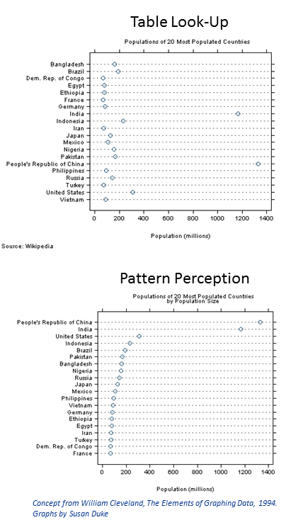
Graphical perception

